Slide 1
PUPIL DETECTION
Using OpenCV
Kaivalya Naik - 2017BTECS00014
Digvijay Bedkyale - 2017BTECS00045
Tejas Havale - 2017BTECS00051

Slide 2
OpenCV
Open Source Computer Vision
OpenCV (Open Source Computer Vision Library) is an open source computer vision and machine learning software library. OpenCV was built to provide a common infrastructure for computer vision applications and to accelerate the use of machine perception in the commercial products.

Slide 3
Implementation
Gray Scale Conversion
Filtering
Erosion Transform

Slide 4
Steps to detect the pupil
Load the image.
Make it invert.
Convert image to grayscale then convert to binary.
Apply Gaussian Blur.
Define size of kernel & apply Erosion transform.
Use binary filter by taking threshold value 210.
Find the biggest object.
Find that object's center point and height.
Highlight the area of concern.

Slide 5
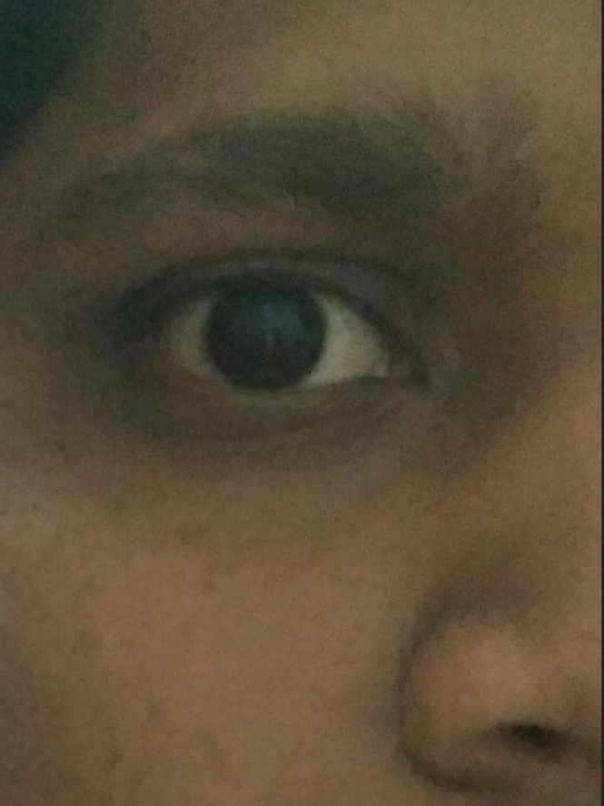
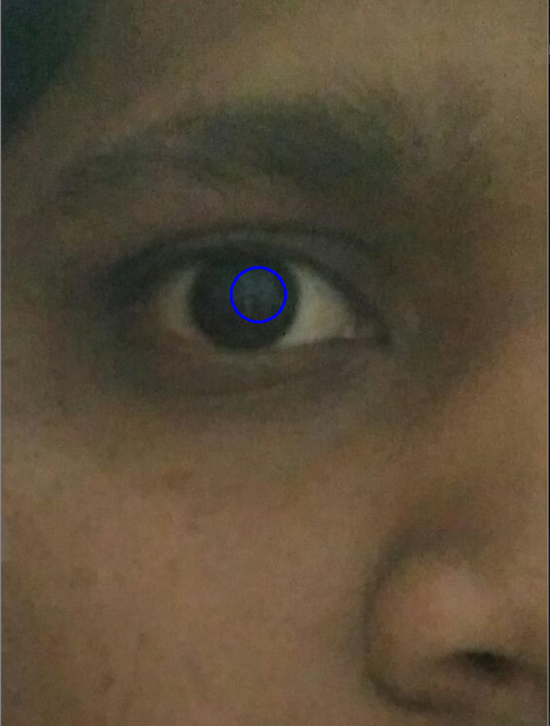
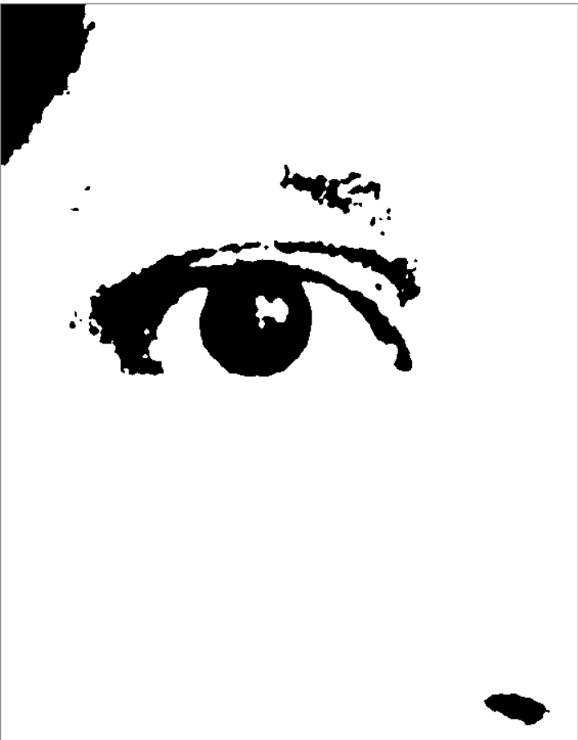
Comparison:
Input:
Output:

Slide 6
Applications of Pupil Detection:
Major application of pupil detection is eye-ball tracking.
Pupil detection plays major role in driverless car system.
It is useful in gaze estimation.
It has applications in health monitoring.
One of the biggest of Pupil detection and recognition is in security.

Slide 7
THANK YOU

